Slide 1
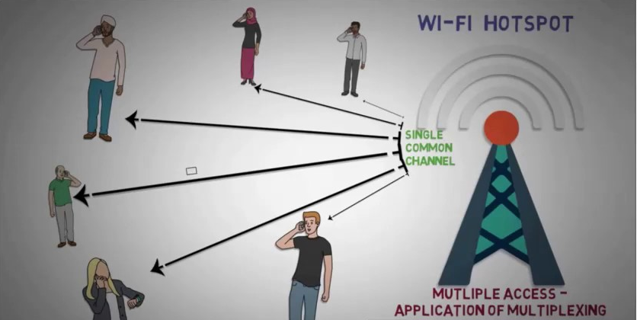
MULTIPLE ACCESS TECHNIQUES

Slide 2
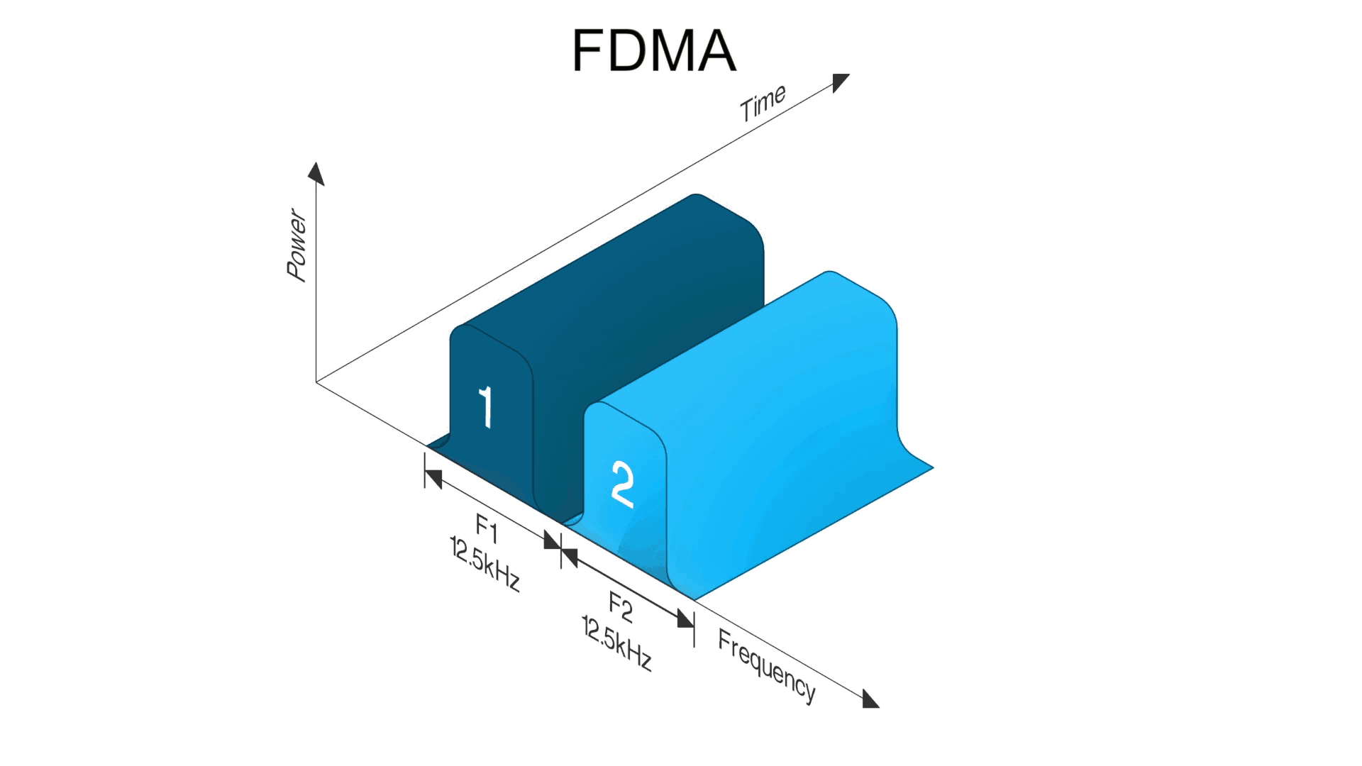
OVERVIEW
Introduction to Multiple Access
FDMA
TDMA
Spread Spectrum Multiple Access
SDMA
OFDMA

Slide 3
Frequency Division Multiple Access
The user is assigned a specific frequency band in the electromagnetic spectrum, and during a call that user is the only one who has the right to access the specific band.
Total system bandwidth is divided into narrow frequency slots. Each user is allocated a unique frequency band or channel.
A user is free to transmit or receive all the time on its allocated radio channel, but the cost of transceiver is high, as each has to be designed on a different band

Slide 4
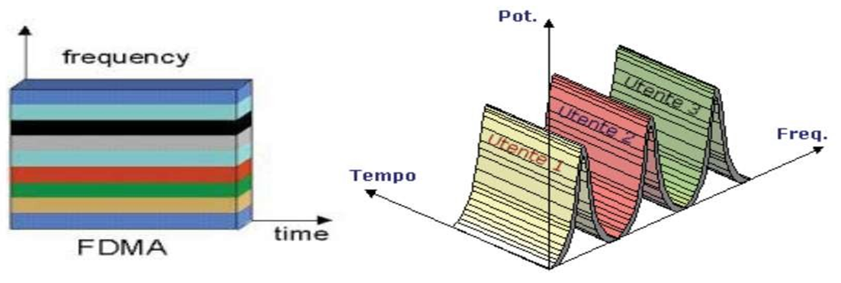
Frequency Division Multiple Access
Each user transmits with no limitations in time, but using only a portion of the whole
available frequency bandwidth.
Different users are separated in the frequency domain.

Slide 5

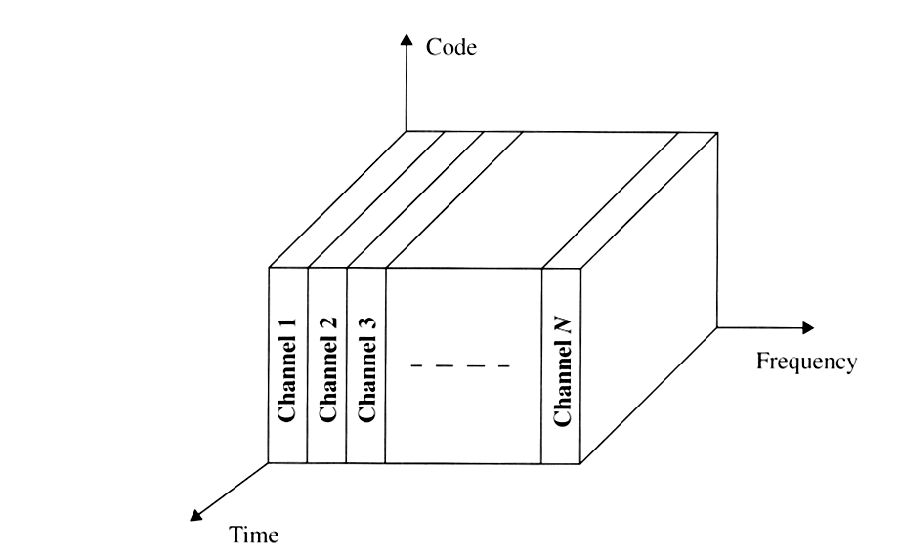



Frequency Division Multiple Access
GUARD BANDS
To avoid interference
USER 1
USER 3
USER 2

Slide 6
Features of FDMA
FDMA channel carries only one phone circuit at a time.
If an FDMA channel is not in use, then it sits idle and it cannot be used by other users to increase share capacity.
After the assignment of voice channel ,BS and the MS transmit simultaneously and continuously.
bandwidths of FDMA systems are generally narrow
Symbol time is large compared to the average delay spread.

Slide 7
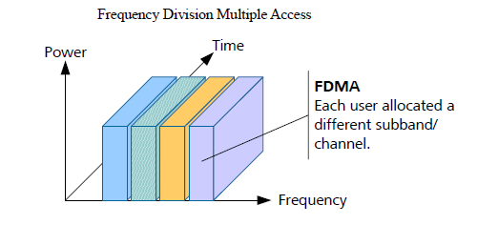
Features of FDMA
The complexity of the FDMA mobile systems is lower than that of TDMA mobile systems.
FDMA requires tight filtering to minimize the adjacent channel interference.

Slide 8
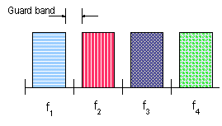
GUARD BANDS
Between the different used frequency channels is a small amount of bandwidth not used. This space is called a guard band.
This bandwidth is necessary to cater for instability of the sender, frequency shifts due to movement (the Doppler effect) and no-ideal filtering.

Slide 9
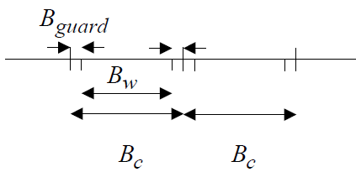
CHANNEL ASSIGNMENT
All channels in a cell are available to all the mobiles. Channel assignment is
carried out on a first-come first- served basis.
The number of channels, given a frequency spectrum BT , depends on the modulation technique and the guard bands between the channels. These guard bands can be used to minimize adjacent channel interference.

Slide 10
FDMA compared to TDMA
Fewer bits for synchronization
Fewer bits for framing
Higher cell site system costs
Higher costs for duplexer used in base station and subscriber units
FDMA requires RF filtering to minimize adjacent channel interference

Slide 11
Nonlinear Effects in FDMA
Many channels - same antenna
For maximum power efficiency operate near saturation
Near saturation power amplifiers are nonlinear
Nonlinearities causes signal spreading
Intermodulation frequencies

Slide 12
Nonlinear Effects in FDMA
IM are undesired harmonics
Interference with other channels in the FDMA system
Decreases user C/I - decreases performance
Interference outside the mobile radio band: adjacent-channel interference
RF filters needed - higher costs

Slide 13
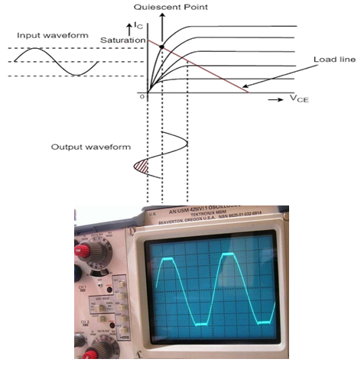
Nonlinear Effects in FDMA

Slide 14
Number of channels in a FDMA system
Bt - 2Bguard
N=
Bc
N - number of channels
Bt - total spectrum allocation
Bguard - guard band
Bc - channel bandwidth

Slide 15
Example: Advanced Mobile Phone System
AMPS
FDMA/FDD
analog cellular system
12.5 MHz per simplex band - Bt
Bguard = 10 kHz ; Bc = 30 kHz
12.5E6 - 2*(10E3)
N=
= 416 channels
30E3

Slide 16
ADVANTAGES
If channel is not in use, it sits idle
Channel bandwidth is relatively narrow (30kHz)
Simple algorithmically, and from a hardware standpoint
Fairly efficient when the number of stations is small and the traffic is
uniformly constant
Capacity increase can be obtained by reducing the information bit rate
and using efficient digital code
No need for network timing
No restriction regarding the type of baseband or type of modulation

Slide 17
DISADVANTAGES
The presence of guard bands
Requires right RF filtering to minimize adjacent channel interference
Maximum bit rate per channel is fixed
Small inhibiting flexibility in bit rate capability
Does not differ significantly from analog system

Slide 18
THANK YOU

